Slide 1
SVM(Support Vector Machine)

Slide 2
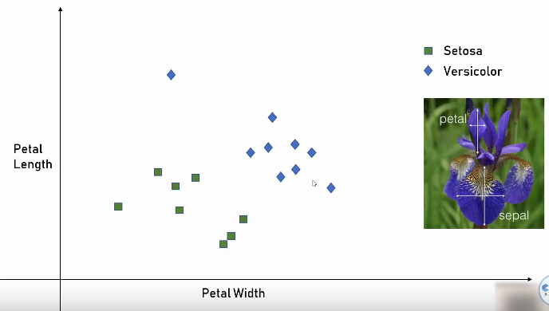
SVM(Support Vector Machine)

Slide 3
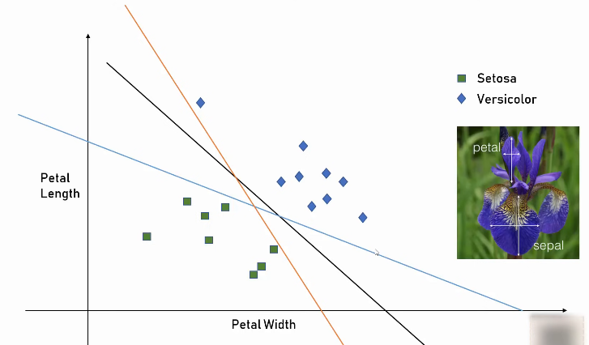
SVM(Support Vector Machine)

Slide 4
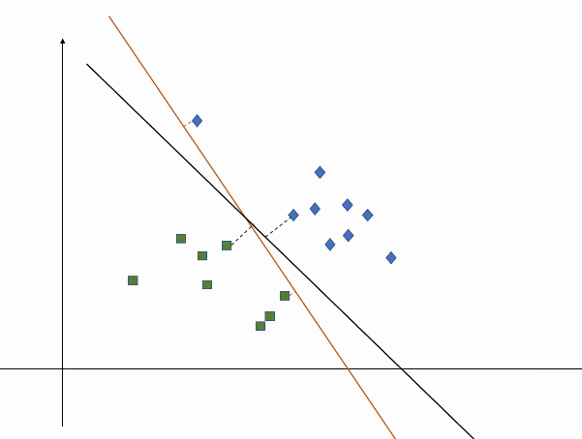
SVM(Support Vector Machine)

Slide 5
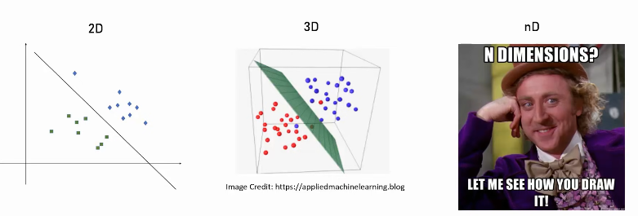
Hyperplan

Slide 6
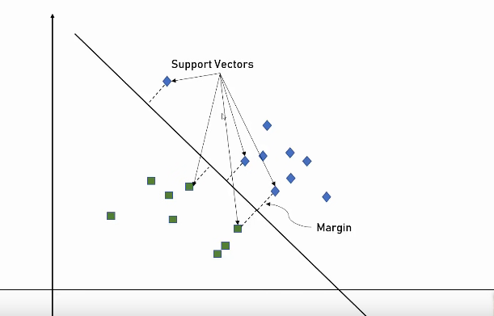
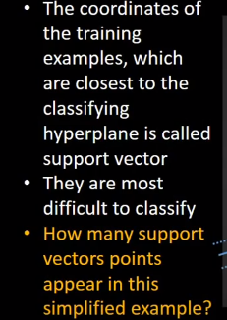
What is Support Vector?

Slide 7
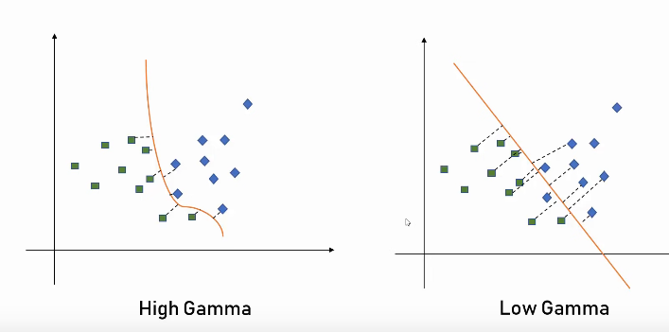
Gamma

Slide 8
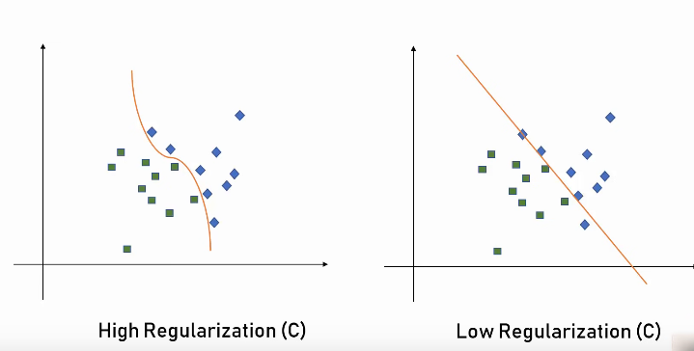
Regularization

Slide 9
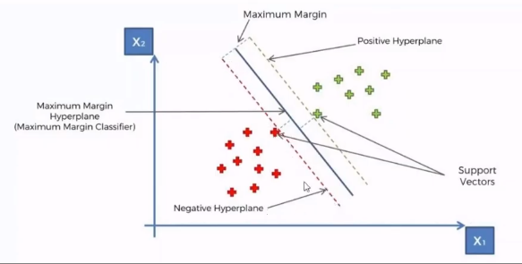
SVM

Slide 10
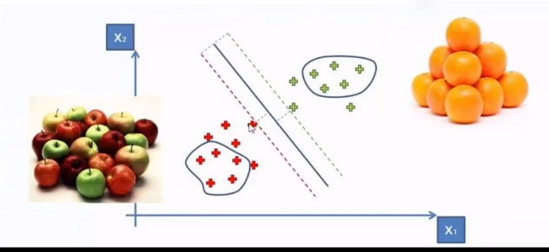

Slide 11
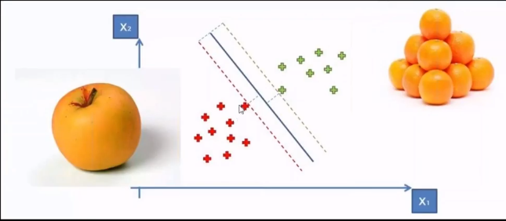

Slide 12
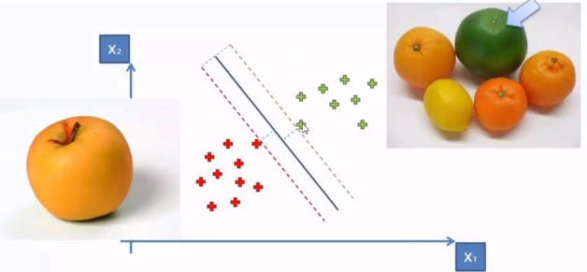

Slide 13
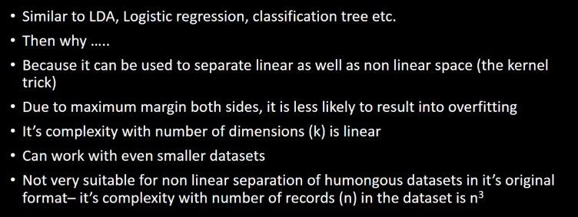
Why SVM is popular?

Slide 14
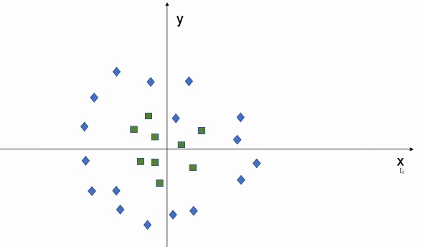
Kernel Trick

Slide 15
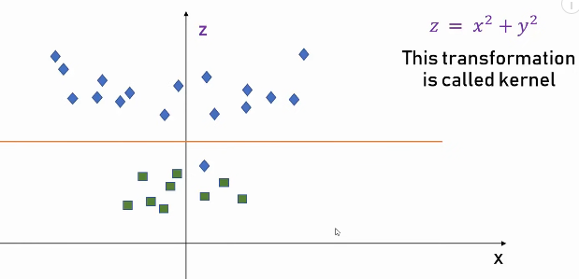
Kernel Trick

Slide 16
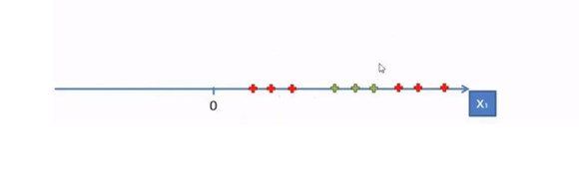
Kernel Trick

Slide 17
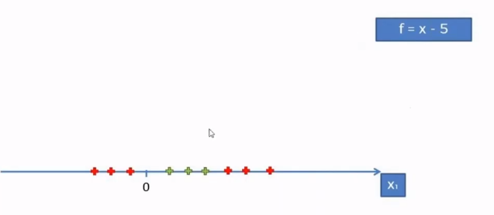
Kernel Trick

Slide 18
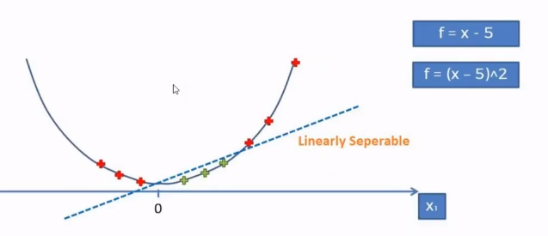
Kernel Trick

Slide 19
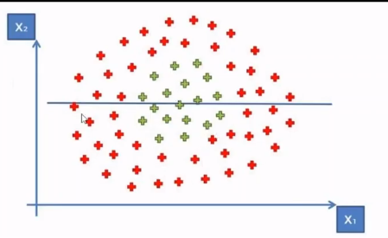
Kernel Trick

Slide 20
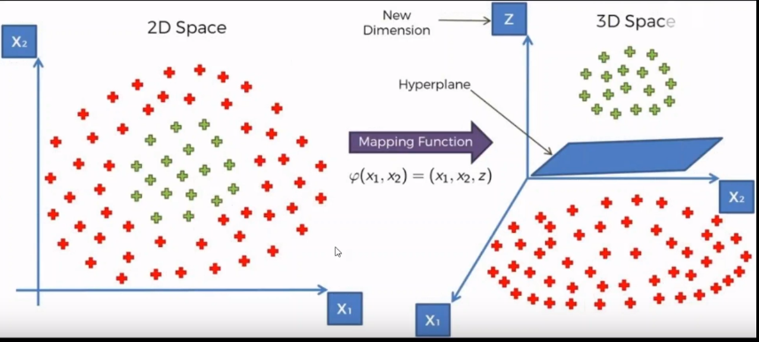

Slide 21
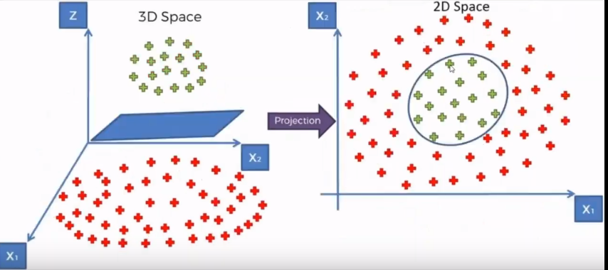

Slide 22
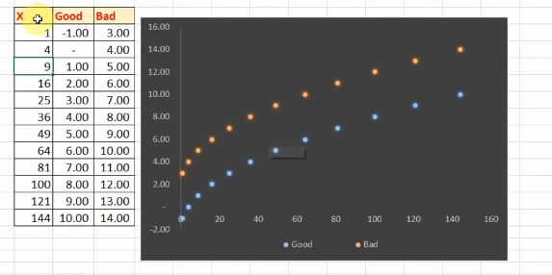
Example1

Slide 23
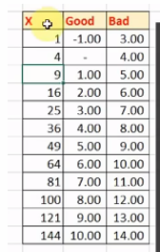
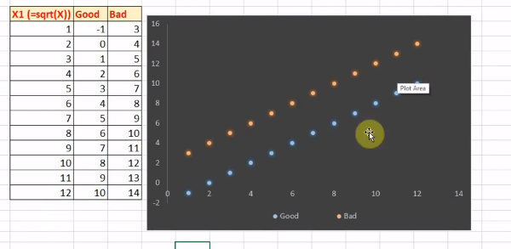
Example1

Slide 24
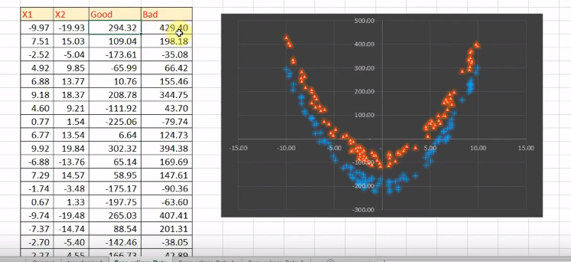
Example2

Slide 25
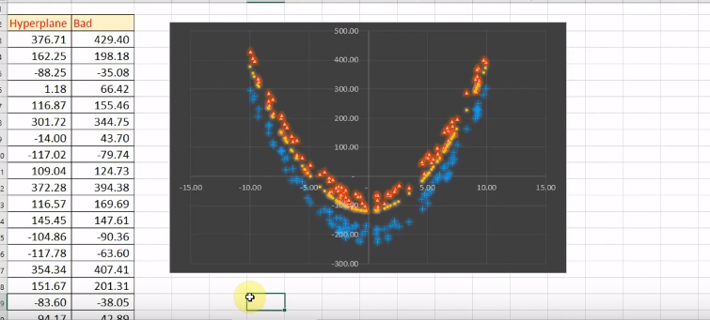
Example2

Slide 26
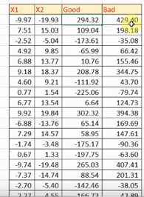
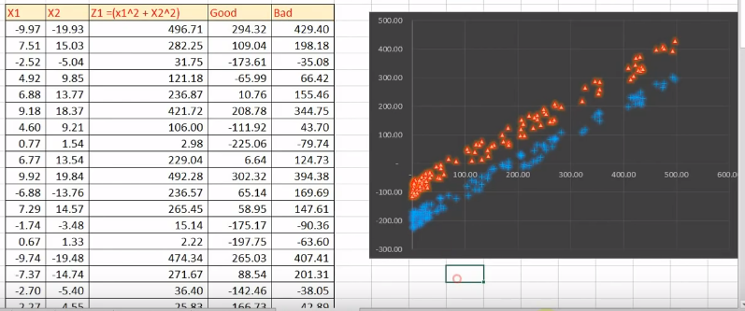
Example2

Slide 27
SVM Applications
SVM has been used successfully in many real-world problems
- text (and hypertext) categorization
- image classification
- bioinformatics (Protein classification,
Cancer classification)
- hand-written character recognition

Slide 28
Weakness of SVM
It is sensitive to noise
- A relatively small number of mislabeled examples can dramatically decrease the performance
It only considers two classes
- how to do multi-class classification with SVM?
- Answer:
1) with output arity m, learn m SVM’s
SVM 1 learns “Output==1” vs “Output != 1”
SVM 2 learns “Output==2” vs “Output != 2”
:
SVM m learns “Output==m” vs “Output != m”
2)To predict the output for a new input, just predict with each SVM and find out which one puts the prediction the furthest into the positive region.

Slide 29
Reference
https://www.youtube.com/watch?v=Q_A6Is-DY50
https://www.youtube.com/watch?v=Ll8fhDdpEbA&list=PL4gu8xQu0_5JdEqxU_FcY2x2aPte_BzF5&index=7
https://www.youtube.com/watch?v=DIRDA5-lY2k&t=118s
https://www.youtube.com/watch?v=ikt7Qze0czE
https://drive.google.com/file/d/0Byo-GmbU7XciMUtJalFMUnlDRnM/view
https://www.youtube.com/watch?v=IyHLdiUBunc&t=64s
https://www.youtube.com/watch?v=i-5ZeV_LwpoDIRDA5-lY2k
https://www.youtube.com/watch?v=MIQmrBxp2-E

